Slide 1


Project Presentation
Collecting information from sensors
Using drone and LoRaWAN protocol

Slide 2
Background
LoRaWAN is a point-to-multipoint networking protocol that uses Semtech’s LoRa modulation scheme which is designed for long range, low power wide area networks with low cost, mobility, security and bidirectional communication.
LoRaWAN has three classes that operate simultaneously. Each differs from the other by the amount of power its operation requires.
LoRa works by moving an RF tone around over time in a very linear way.
LoRa transmissions work by chirping, breaking the chips in different places in terms of time and frequency in order to encode a symbol.

Slide 3
Motivation
The GW is physically connected to the drone, the sensors are scattered across a large polygonal area and the server is offline until the drone returns and unloads the data.
We need a protocol that allows:
Long range communication
Low power usage
Synchronized for usage with multiple end nodes
LoRaWAN is the best wireless protocol solution for our task!

Slide 4
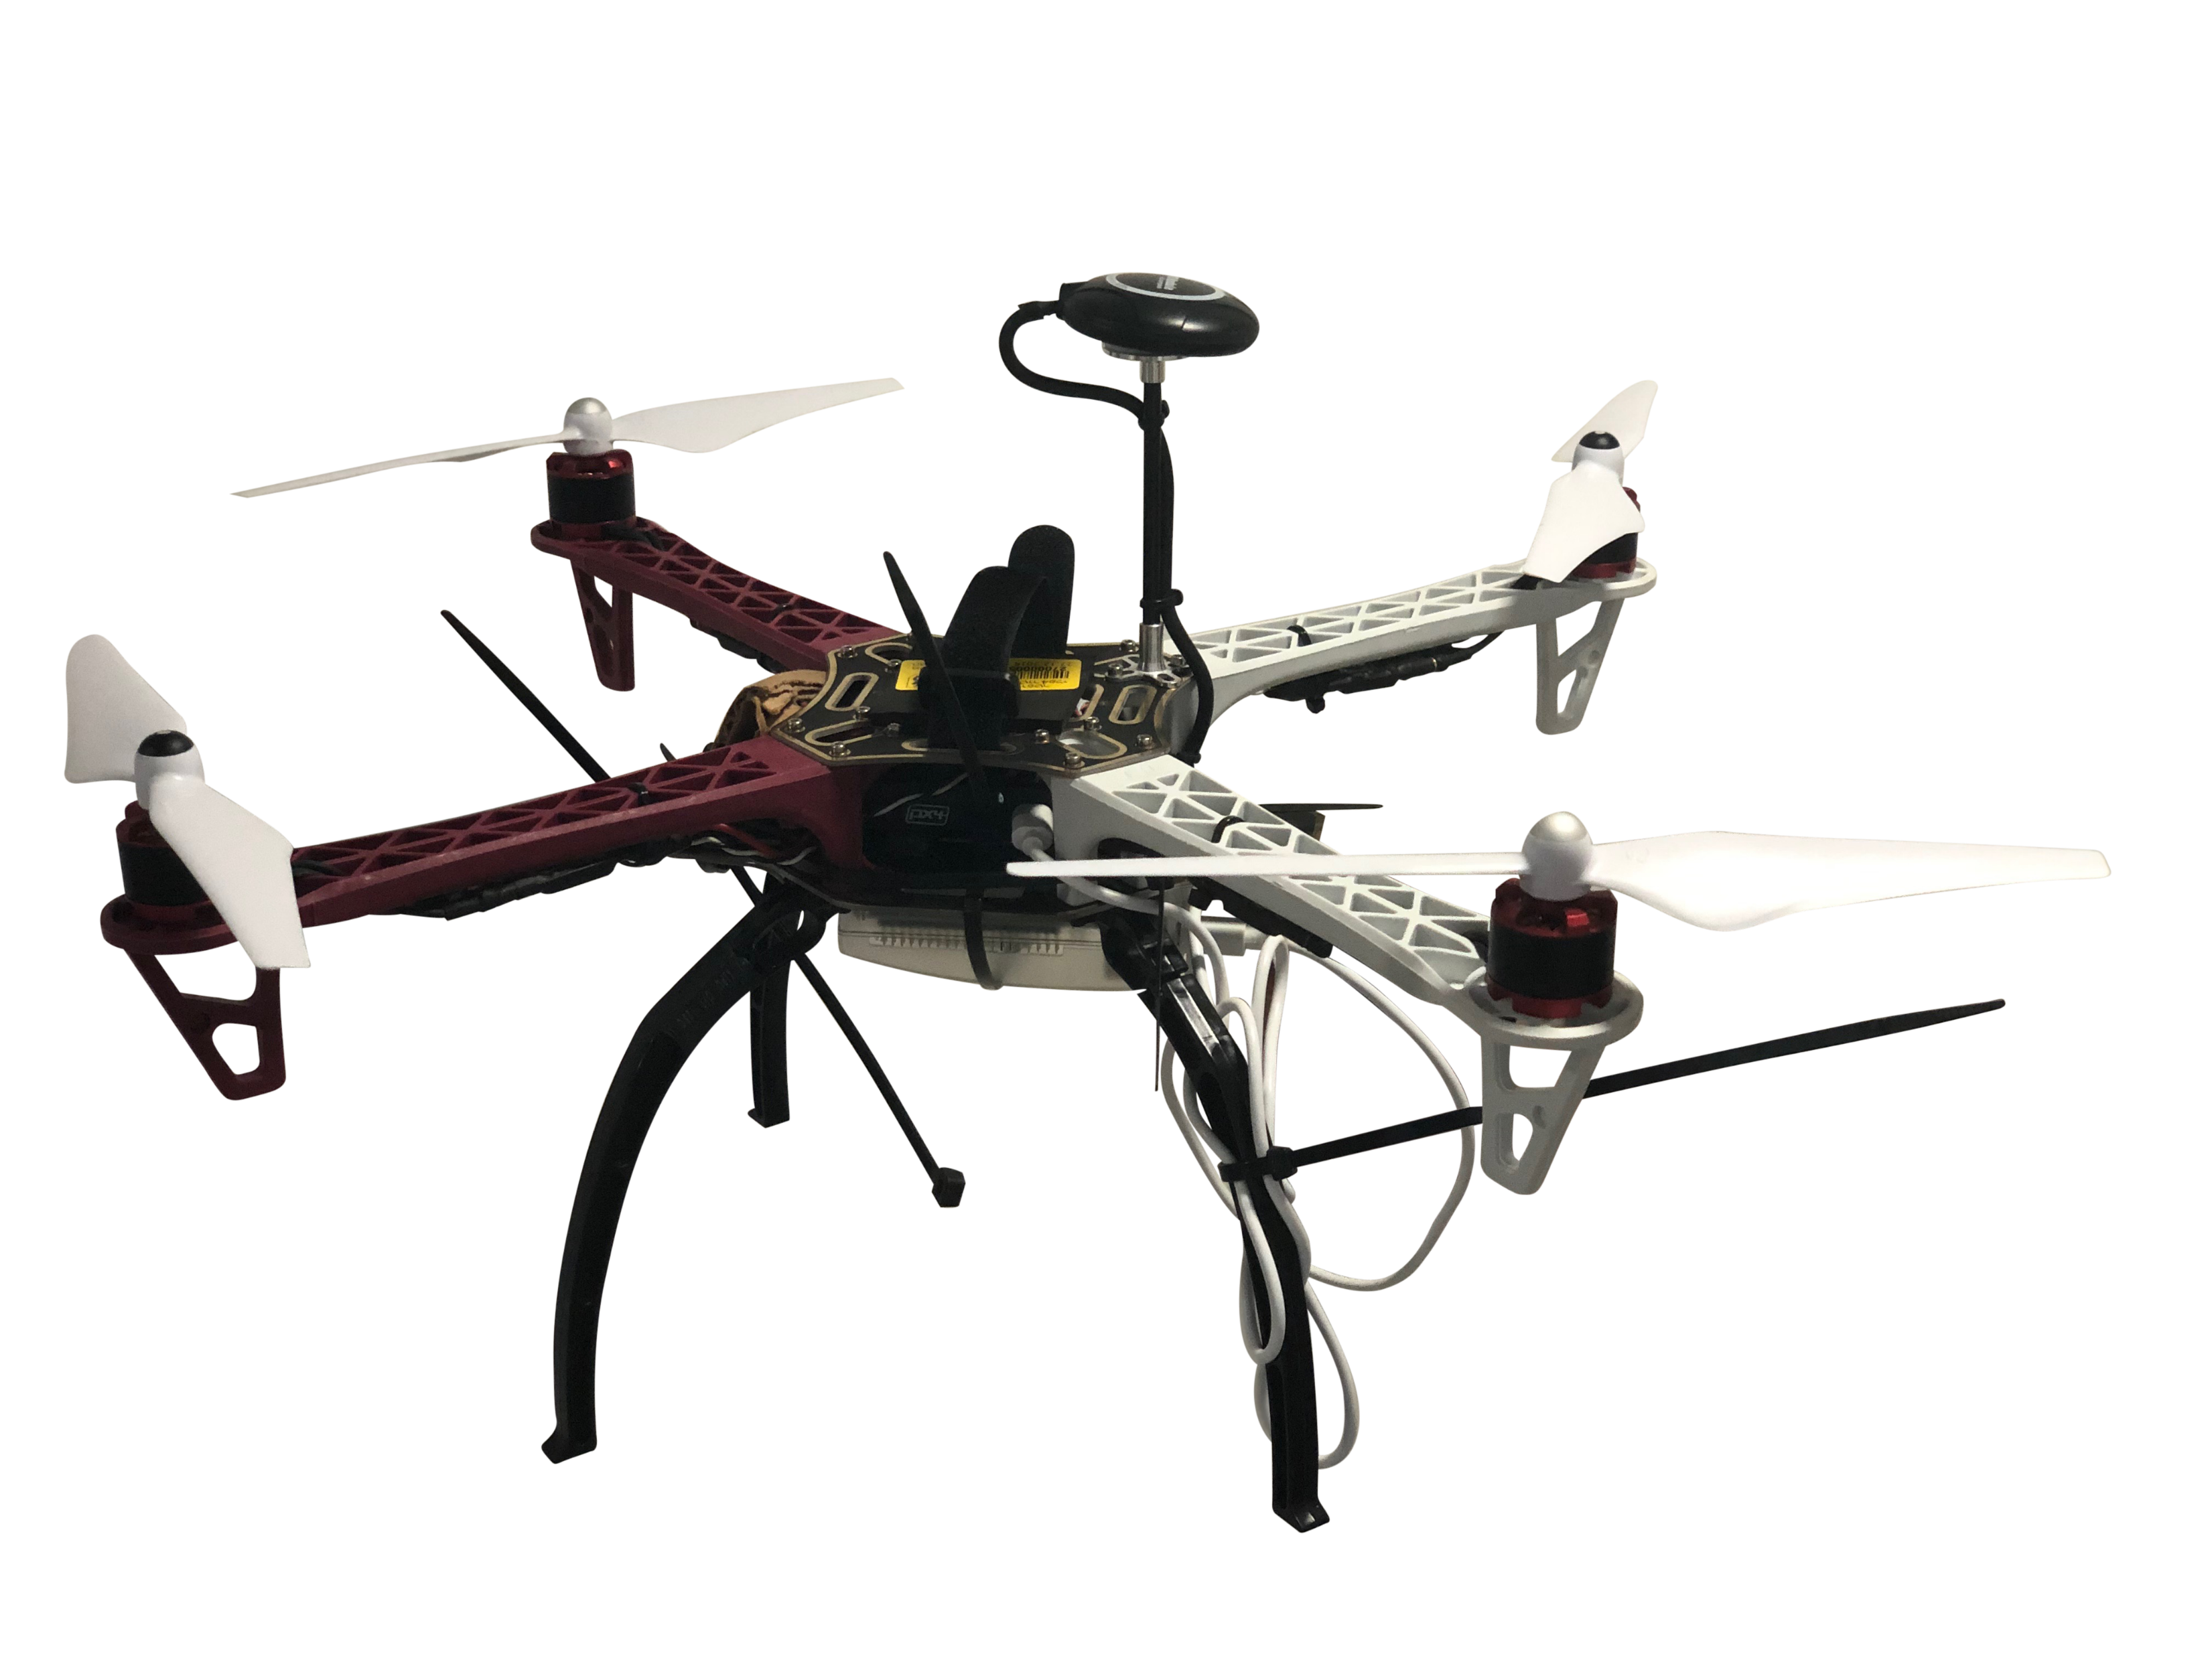
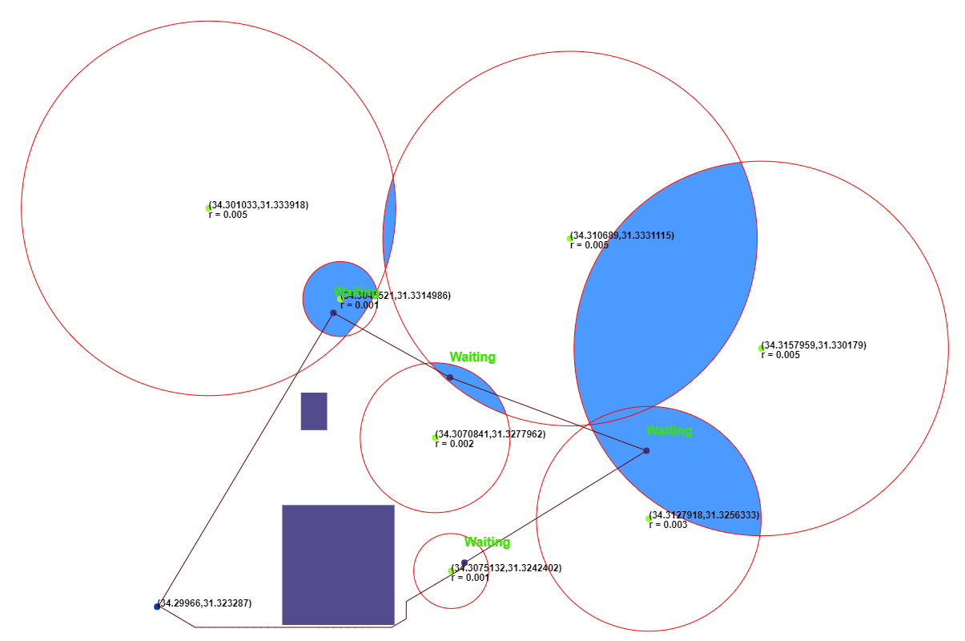
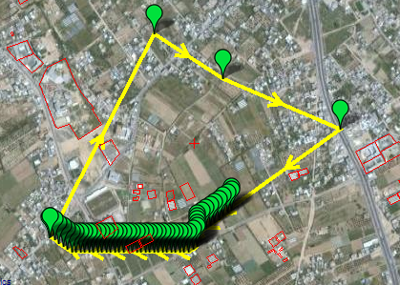
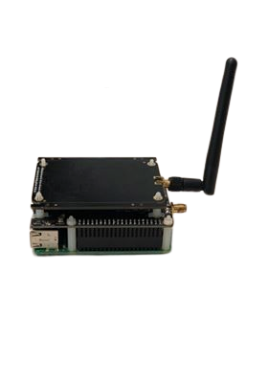
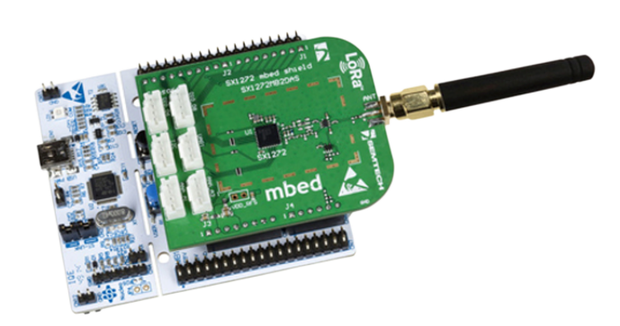

Architecture – High level
Path Planning
Mission Planner
Drone
LoRaWAN Server
LoRaWAN GW
LoRaWAN Sensors

Slide 5
Project Targets & Solution
Learn
Learn about LoRa and LoRaWAN protocols while getting practical experience in modifying said protocols for our purpose.
Modify
Allow GW to store packets received from sensors and then unload them to server via Ethernet.
Create
Create a smart path planning algorithm for the drone to collect data from multiple scattered sensors with different signal radii.
Experiment
Do live experiments of flying the drone to confirm that said algorithm works and that data from sensors has successfully been gathered.

Slide 6

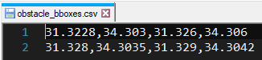
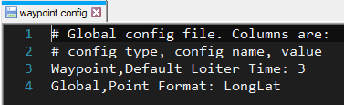
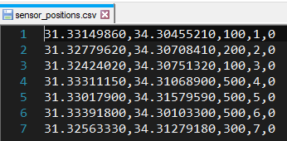
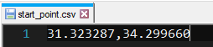
Solution – Path Planning (1)
Path planning algorithm receives an input of:
Start point
Sensor points and their metadata (signal radii, SNR and ID)
Obstacle bboxes
External config file

Slide 7
Solution – Path Planning (2)
Using Python we generate a .waypoint file to be read and processed by mission planner
Using Python and JavaScript we generate an animated simulation of the path of the drone in 2d.

Slide 8
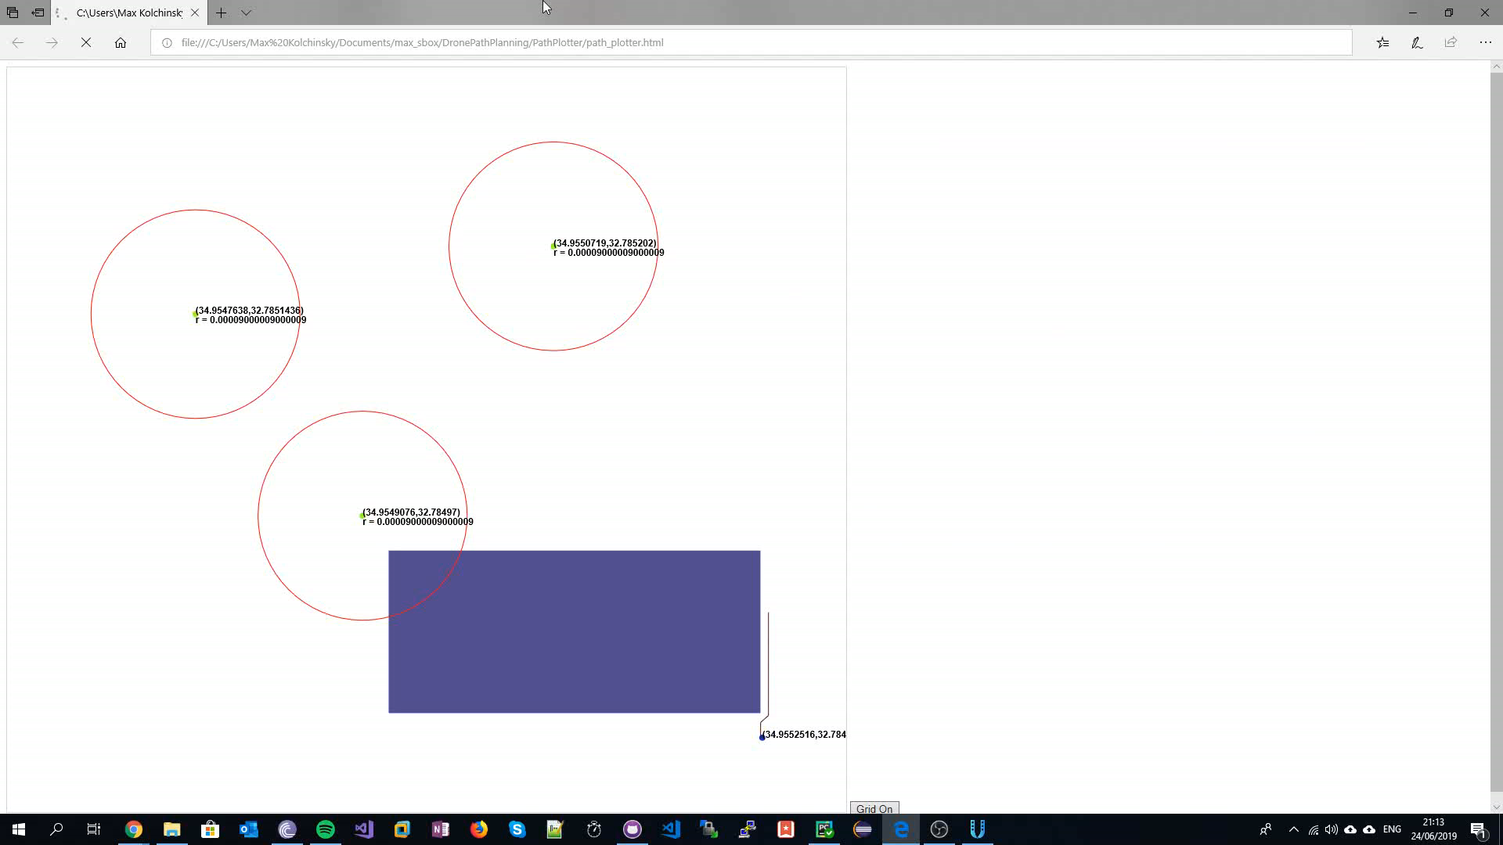
Solution – Path Planning Simulation

